Slide 1
Intro to CSS
CPRO 1101
Kirk Rieberger

Slide 2
Notes
Please choose your assignment groups. I will randomly assign groups 1 week from today if they are not put in this forum.
Reminder: groups of 3, names and IDs in the forum thread. One post per group.
I will release A1 next week.

Slide 3
What is CSS?
Stands for Cascading (Cascaded) Style Sheets​
Allows us to add “styles” to our webpages
A .css file is a text file just like HTML​
Based on rules that target specific elements

Slide 4


Basic Structure
CSS rules have two basic parts:​
The selector and the declarations.​
The selector determines what elements the declarations are applied to​
The declaration states the styling to be applied​
Declarations are broken into property/value pairs​
The rule’s declarations are surrounded by curly braces​
Declarations end with a semicolon​
​
Here, h1 is the selector, color is the property, and red is the value​
This rule will make all h1 elements have red text​

Slide 5
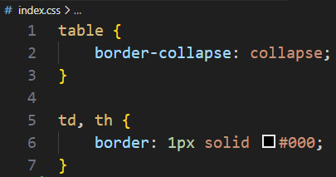
Stylesheet Formatting
Stylesheets only contain CSS rulesets
No HTML markup, or other boilerplate
This is a complete stylesheet:
Note: This formatting applies to internal and external CSS. Inline CSS is usually written on one line to match the HTML attribute style.

Slide 6
Adding CSS to HTML
There’s 3 main ways to add styling:​
External CSS​
Internal CSS​
Inline CSS​
External CSS is when we have a separate .css file we link to​
Internal CSS is when we have a <style> element in our document’s <head>​
Inline CSS is when we use the style attribute in an element​
Note: The only difference between these locations is the precedence

Slide 7
External CSS
The preferred method of using CSS is External CSS
External CSS keeps our HTML more readable​
How does our HTML know where the style sheet is?​
The link element!​
rel defines the relationship between the HTML file and the external file​
href works just like the anchor element​

Slide 8
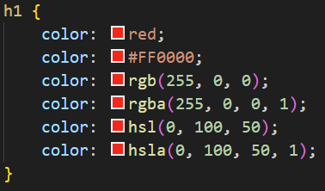
CSS Colours
One of the most basic functions of CSS is colouring text​
Colours are specified by colour names or colour value directly​
Supported colour formats: RGB, HEX, HSL, RGBA, and HSLA​
RGBA and HSLA allow us to define transparency by adding an alpha channel​
Note: Hex values can be input with 6 digits or 3. If each colour pair is the same, I.e.: #AABBCC, this can be shortened to #ABC in CSS.

Slide 9
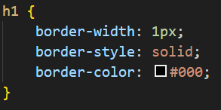

Borders
Another common CSS use is adding borders​ to boxes
Borders are made of 3 basic parts:​
Width is how thick the border is​
Style is how the border appears​
Color defines what colour the border is​
These three are used together so often that there’s a shorthand version:​

Slide 10
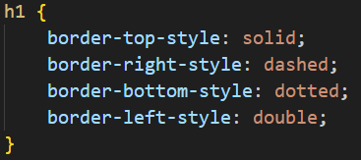
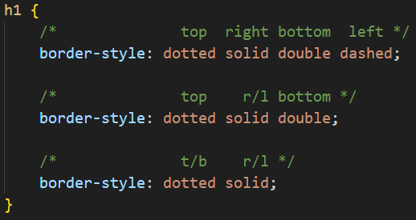
Borders
We can also define rules for specific sides of the border:​
​
​
​
​
​
Like before, there’s a shorthand for this: border-style​:
Note: this works for width and color too, just replace style!

Slide 11


Backgrounds
background-color – Solid colour background​
background-image – Uses a link to an image​

Slide 12
CSS Box Model
CPRO 1101
Kirk Rieberger

Slide 13
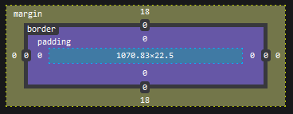
Box Model
Every piece of content is surrounded by a series of boxes​
We can manipulate these boxes to determine how elements render​
Boxes mainly come in the two types we’ve seen before: block and inline​
This property can be set with the CSS display property​

Slide 14
Parts of the Box
The Content Box – The area where the actual content is displayed
Controlled by the width and height properties
The Padding – The whitespace between the content and the border
Controlled by the padding property
The Border – Wraps the content and the padding. Can be visible or invisible
Controlled by the border property
The Margin – The whitespace outside the border
Controlled by the margin property

Slide 15
Block-Level Elements
Element is displayed on a new line, one after another
Width and height are respected
Padding, border, and margin cause other elements to be pushed away
If a width is not specified, the box will fill its parent container’s width
Elements like p, h1, and div default to block type

Slide 16
Inline Elements
Elements are not displayed on a new line
Width and height properties are not applied
Content box is always the size of the content
Top and bottom padding, margin, and border will apply, but won’t cause other inline boxes to move away
Left and right padding, margin, and border will apply and will cause other boxes to move away
a, em, and span elements default to inline style

Slide 17
Inline-Block Elements
Takes some properties from block and inline elements
Width and height properties are respected
Padding, border, and margin will push other elements away
Does not create a new line
We have to specify display: inline-block; in CSS
Useful for making links in navbars taller

Slide 18
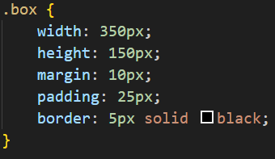
Size of the Displayed Box
Say we have a box with the following properties:
How big will the displayed box be?
The actual space take up by the box will be 410px
wide and 210px tall.
Margin affects the amount of space a box takes up on the page, but not the size of the box itself.
We can optionally set box-sizing: border-box
This option means that we can set the absolute width of a box with the width property

Slide 19
Margin Collapsing
Comes into play if two element’s margins touch
Results vary based on if margins are positive or negative:
Two positive margins combine into one margin with the value of the larger margin.
Two negative margins combine into one margin with the value of the smaller margin.
If one is positive and one is negative, the negative margin will be subtracted from the positive one

Slide 20
CSS Measurements
There are two types of lengths in CSS: absolute and relative
Absolute lengths are not relative to anything else, they will always appear the same size. Try to avoid these as they are not responsive.
Common absolute lengths: pixels – px, points – pt, centimeters – cm, millimeters – mm
Relative units are sized based on something. This may be the size of the viewport, the parent element’s width, etc.
Common relative lengths: em – font size of parent element, vw – 1% of the viewport’s width, lh – line height of the element
Percentages work similar to relative units. Percentages are relative to the parent element. If we set width: 50%;, the element will be half as wide as its parent

Slide 21
Participation
Finish setting up and publishing a GitHub Page.
This page should include external CSS
Please submit the link to view your page on BlackBoard
I.e.: I would submit krieberger.github.io
Note: it can take up to 10 minutes for GitHub to refresh your page​
You can still make changes in real-time on your computer​

